Slide 1
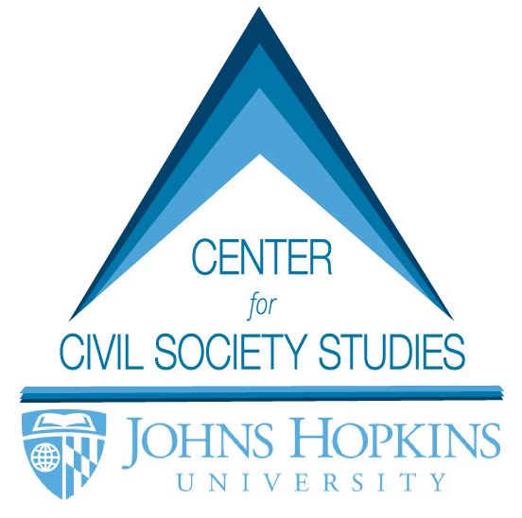
WHAT CAN
WE DO FOR DC NONPROFITS?
LESTER M. SALAMON lsalamon@jhu.edu

Slide 2
Who we are
A leading source of ground-breaking knowledge about the nonprofit sector, philanthropy, social investing, and the tools of government in the U.S. and around the world.
Active in 40 countries—Latin America, Africa, W. Europe, Central and Eastern Europe, Pacific Rim, C. and SE Asia
Wide range of domestic and international partners
Specialize in objective empirical and analytical work
Solid record of achievement over 20-year period

Slide 3
what we believe
Neither governments nor businesses can solve global challenges on their own.
Civil society organizations an invaluable renewable resource.
Not making effective enough use of this resource
Gross lack of basic information a major reason.
JHU/CCSS forging the tools that can allow us to do better!

Slide 4
what we do
Build networks
Generate new knowledge
Institutionalize capabilities
Design assessment tools
Provide training
Change thinking

Slide 5
our metaphor

Slide 6
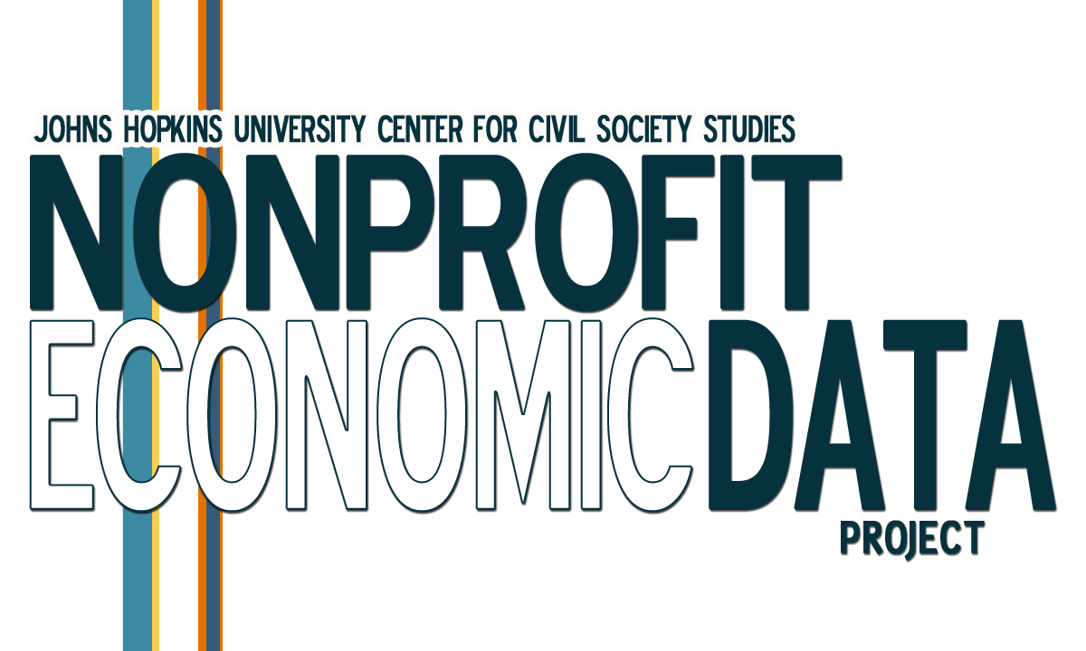

Slide 9
philanthropy’s big bang
Standard & Poor’s
Pooled Income Funds
Prosper.com
Network for Good
Bovespa
Social enterprise
NESTA
Impact investing
Gifts in Kind
Volkswagen Foundation
Guggenheim Partners
Neighborhood Housing
Services of America
Foursome Investments (UK)
Compagnia di San Paolo
Aquinas Growth Fund
Innovest Strategic
Value Advisors
Charitable Remainder Trust
Venture philanthropy
DonorsChoose.org
Oppenheimer Legacy
Program
Blended value
Schwab Charitable Fund
Kiva
California Wellness
Foundation
Women’s Funding Network
Securitization
Social Capital Partners (Canada)
Sea Change Capital Partners
Accion
Keystone
TechSoup
Fidelity Charitable Gift Fund
Community Reinvestment Fund
Community Wealth Ventures
Acumen Fund
Mission investing
New Profit
Bank Intesa (Italy)
echoDonations
Charity Navigator
Impact Partners (India)
Social Venture Partners
Calvert Foundation
Vanguard Charitable Endowment Program

Slide 10
putting civil society on the economic map of the world

Slide 11
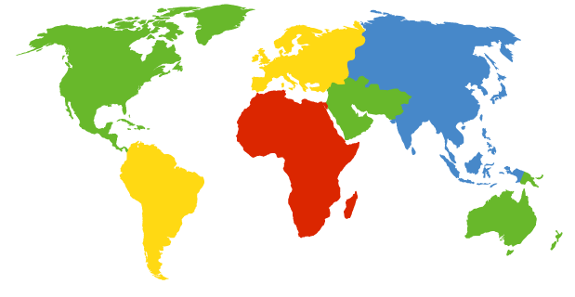
building networks: cnp project countries
Denmark
Sweden
The Netherlands
Switzerland
Czech Republic
Belgium
Finland
United Kingdom
Norway
Austria
Poland
France
Italy
Romania
Canada
Germany
Slovakia
Russia
Hungary
United States
Ireland
Spain
Japan
Mexico
Portugal
Morocco
Turkey
Korea
Colombia
Israel
The Philippines
Ghana
Lebanon
India
Brazil
Egypt
Kenya
Thailand
Pakistan
South Africa
Tanzania
Chile
Argentina
Uganda
Australia
Peru
New Zealand

Slide 12
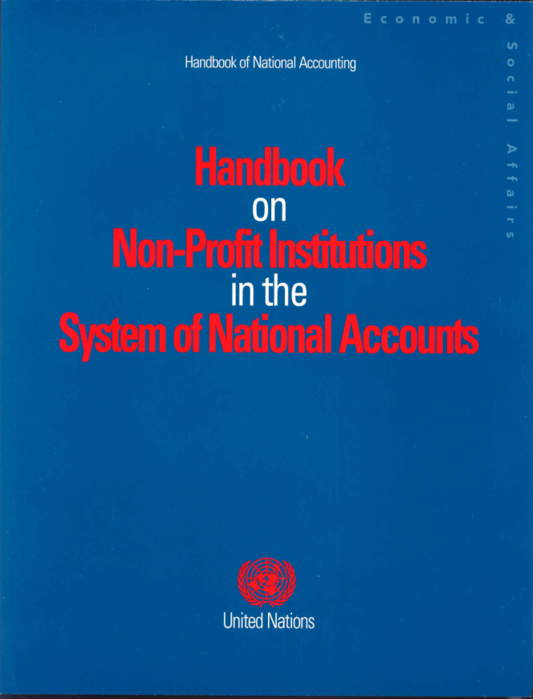
institutionalizing capabilites

Slide 13
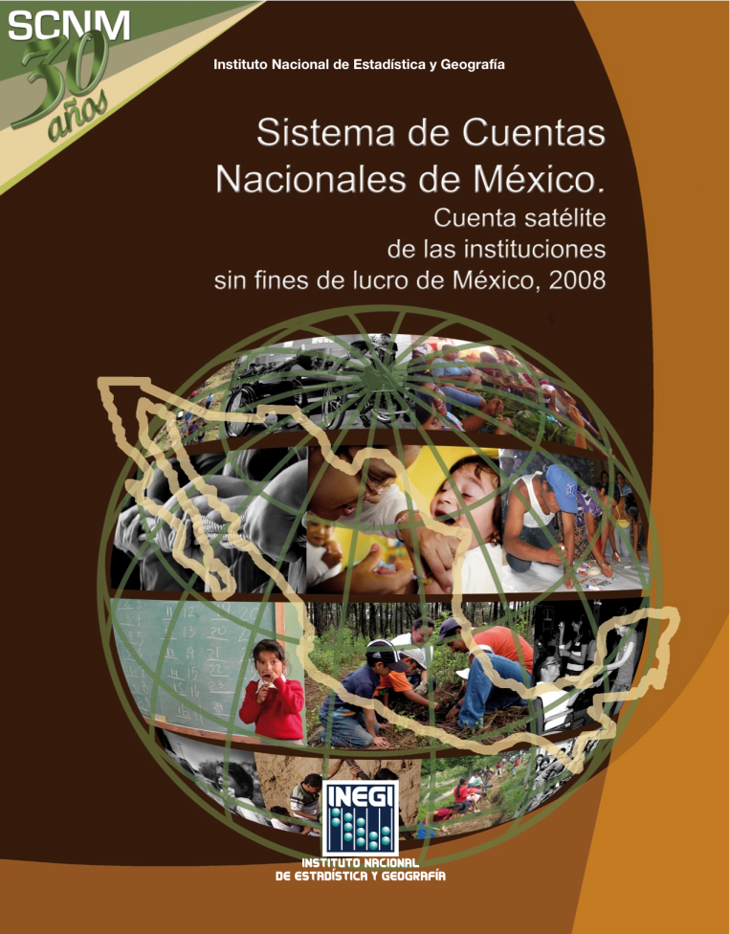
Institutionalizing capabilities: Mexico npi satellite account report
Npi share of employment vs. other industries, Mexico 2008

Slide 14
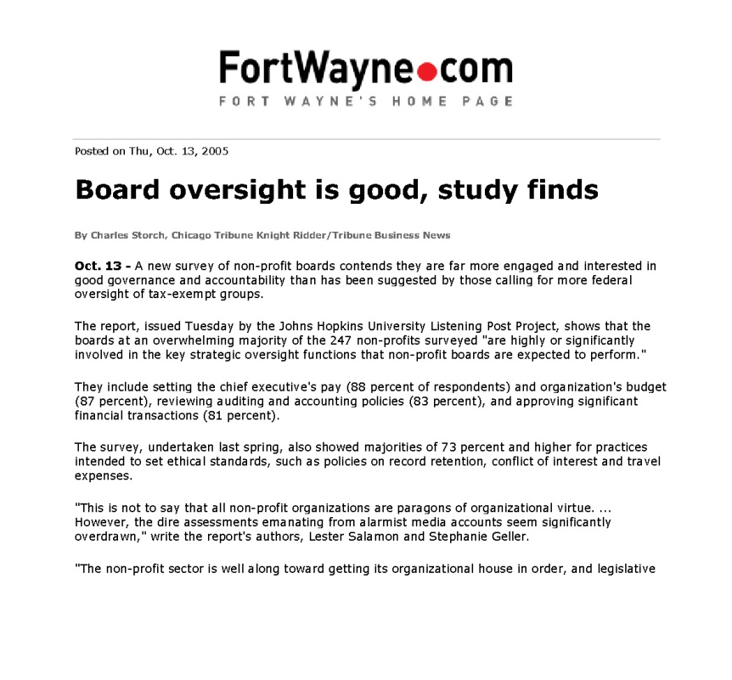
changing thinking

Slide 15
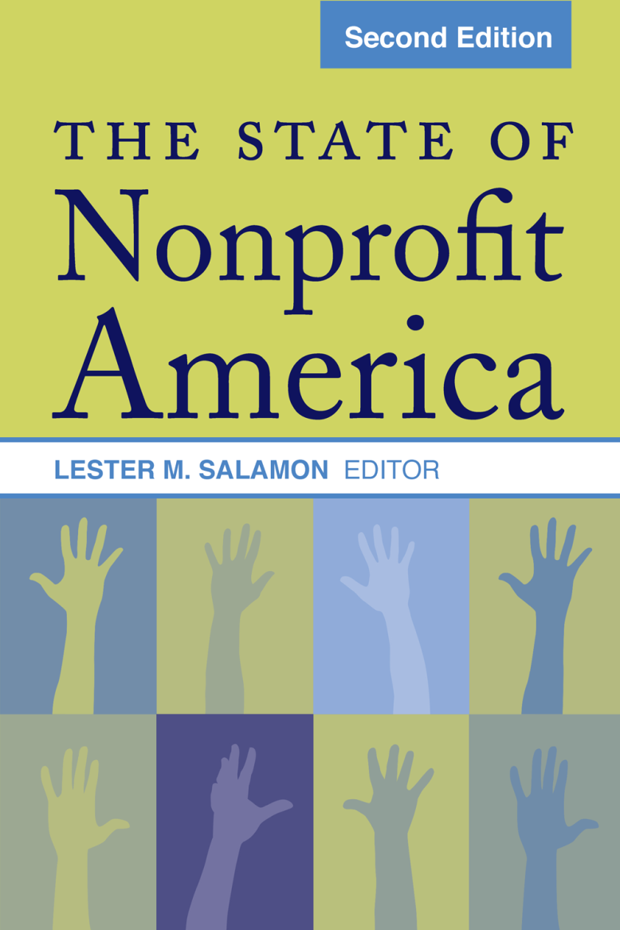
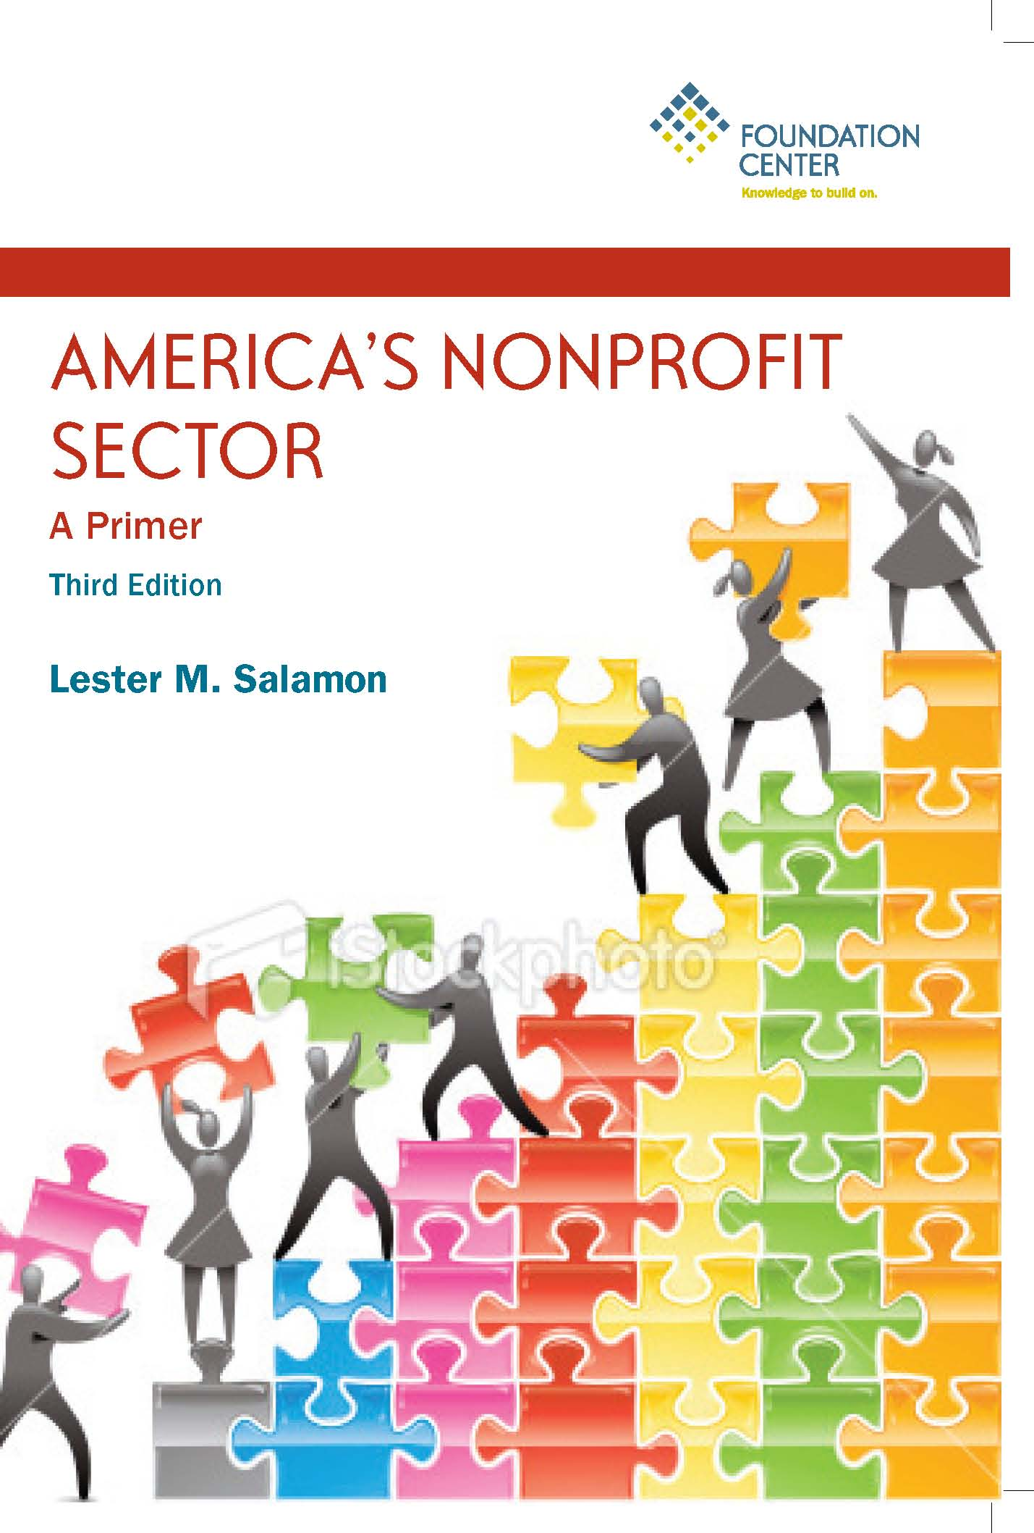
changing thinking

Slide 16
what can we do for dc nonprofits?
Multiple possibilities for supportive activity:
Washington Region Nonprofit Employment Trend Reports

Slide 17
what can we do for dc nonprofits?
Greater Washington Region
Nonprofit Employment Report: 2003

Slide 18
greater Washington region np employment, 2003
218,344 workers
11.2 percent of Greater Washington Region private employment
$9.6 billion in wages, > 10 percent of the total

Slide 19
Employment in Washington Region NONPROFITS vs. Selected Industries*, 2003
335.6
218.3
163.8
Number of employees (in thousands)
68.1
38.4
9.1
501(c)(3)
Federal
government
Construction
Manufacturing
Transportation
Utilities
Organizations
* Industry data cover entire metro area.

Slide 20
Nonprofit Share of Greater Washington Private Employment, by Jurisdiction, 2003
Greater Washington
11.4%
Virginia suburbs
7.0%
Maryland suburbs
8.6%
District of Columbia
24.7%
Falls Church, VA (city)
15.5%
Manassas, VA (city)
12.7%
Alexandria, VA (city)
12.9%
Montgomery, MD
10.2%
Arlington, VA
8.9%
Frederick, MD
8.2%
Fairfax, VA (city)
6.4%
Fairfax, VA
6.2%
Prince Georges, MD
6.0%
Prince William, VA
4.2%
Loudoun, VA
3.4%
Percent of private employment

Slide 21
Growth of Nonprofit Employment in the Greater Washington Region, 1995-2003
Greater
Washington
33.2%
Virginia suburbs
44.4%
Maryland suburbs
32.0%
District of
Columbia
28.0%
Percent change compared to 1995 level

Slide 22
Distribution of Nonprofit Employment Across the Greater Washington Region, 2003
Virginia
suburbs
27%
District of
Columbia
47%
Maryland
suburbs
26%
N = 218,344

Slide 23
Average Annual Nonprofit vs. For-Profit Job Growth in the Greater Washington Region, 1995-2003
4.6%
Nonprofit
For-profit
4.1%
3.7%
2.8%
Average annual growth rate
2.3%
2.4%
0.2%
0.0%
1995 - 2000
2000 - 2002
2002 - 2003
1995 - 2003

Slide 24
Nonprofit Employment, by Field, Greater Washington Region vs. the Nation, 2003
38%
Greater Washington
United States
22%
Percent of total nonprofit employment
20%
14%
15%
12%
13%
11%
10%
7%
5%
2%
Hospitals
Educational
Membership
Professional
Social
Nursing &
services
organizations
& technical
assistance
residential
services
care facilities

Slide 25
Nonprofit Employment by Field, DC vs. MD and VA Suburbs, 2003
58%
Health & social services
31%
12%
Education
29%
Membership organizations
12%
20%
Professional services
12%
MD & VA suburbs
13%
District of Columbia
1%
Arts & recreation
2%
Other
5%
6%
Percent of nonprofit employment in area

Slide 26
Nonprofit share of greater Washington Region Private Employment Growth, 1995-2003
Greater Washington
10.2%
16.0%
21.2%
District of Columbia
53.8%
7.5%
Maryland suburbs
13.0%
Nonprofit share of 1995 private employment
Nonprofit share of 1995-2003 private employment growth
6.2%
Virginia suburbs
10.0%

Slide 27
Nonprofit vs. Average Private Wages* Greater Washington Region, 2003
All private
Nonprofit
$880
$838
$757
$793
$641
$551
$519
Average weekly wages
$493
$495
$448
Nursing homes
Social
assistance
Home health care
Education
Hospitals
*All private data are for the entire MSA.

Slide 28
greater Washington region np employment, 2011
254,935 workers
12.4% of Greater Washington Region private employment
Accounted for 32.4% of all private employment growth between 2003-2011

Slide 29
Nonprofit share of Greater Washington Region private employment, by jurisdiction, 2003 vs. 2011

Slide 30
Nonprofit Share of Greater Washington region Private Employment Growth, by Jurisdiction, 2011

Slide 31
Who we are
WHAT CAN WE DO FOR DC NONPROFITS?
Multiple possibilities for supportive activity:
Washington Region Nonprofit Employment Trend Reports
Washington Region Nonprofit Economy Trend Reports

Slide 32
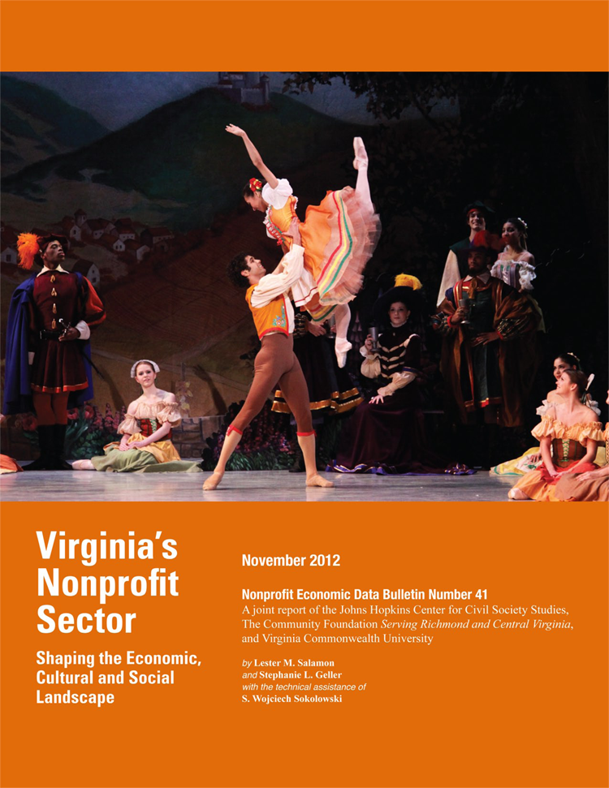

Slide 33
In search of Virginia nonprofits
DATA SOURCES
IRS 990 AND 990PF forms
BLS Quarterly Census of Employment and Wages (QECW)
IRS charitable giving data
Census Bureau volunteering data

Slide 34
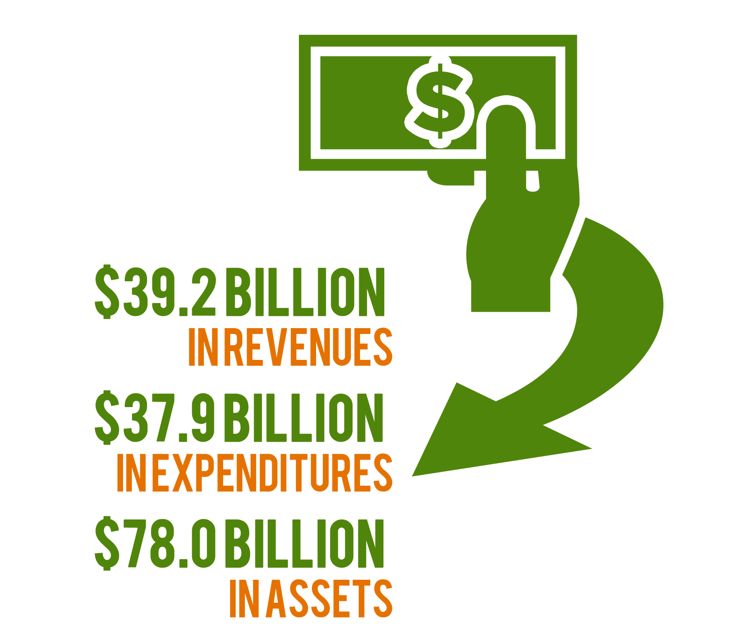
Virginia nonprofit footprint
Source: Lester M. Salamon and Stephanie L. Geller, “Virginia’s Nonprofit Sector: Shaping the economic, cultural, and social landscape” (Johns Hopkins University, 2012).
Available at ccss.jhu.edu.

Slide 35
Average charitable contributions
per $1000 of income, 2009
Source: Lester M. Salamon and Stephanie L. Geller, “Virginia’s Nonprofit Sector: Shaping the economic, cultural, and social landscape” (Johns Hopkins University, 2012).
Available at ccss.jhu.edu.

Slide 36
Foundation Assets per $1,000
of Gross State Product, 2008
Source: Lester M. Salamon and Stephanie L. Geller, “Virginia’s Nonprofit Sector: Shaping the economic, cultural, and social landscape” (Johns Hopkins University, 2012).
Available at ccss.jhu.edu.

Slide 37
WHAT CAN WE DO FOR DC NONPROFITS?
Multiple possibilities for supportive activity:
Washington Region Nonprofit Employment Trend Reports
Washington Region Nonprofit Economy Trend Reports
D.C. Nonprofit Listening Post Tracking System

Slide 38
The Johns Hopkins Listening Post Project
Nonprofit Capital Needs vs. Success Securing Capital, by Purpose
Technology
91%
37%
Program Development
80%
25%
Acquisition/ Renovation of Buildings or Land
77%
39%
Orgs. Needing Capital
Staff
Development
67%
Orgs. Securing Needed Capital
26%
Strategic
Planning
53%
31%
Vehicles/ Equipment
52%
42%
0%
20%
40%
60%
80%
100%
Percent of Organizations

Slide 39
SELECTED “SOUNDINGS”
Budget cuts/financial health
Health benefit costs
Governance and accountability
Capital needs
Workforce
Technology usage and needs

Slide 40
WHAT CAN WE DO FOR DC NONPROFITS?
Multiple possibilities for supportive activity:
Washington Region Nonprofit Employment Trend Reports
Washington Region Nonprofit Economy Trend Reports
D.C. Nonprofit Listening Post Tracking System
Train D.C. Nonprofits for New Frontiers of Philanthropy

Slide 41
ARE DC NONPROFITS ORGANIZATION READY for THE NEW FRONTIERS OF PHILANTHROPY?
“…the definitive chronicle of the innovations that are infusing new life into the well-intentioned but often-staid world of philanthropy.”
~ Mario Marino, Venture Philanthropy Partners
“…a roadmap to the significant revolution underway …in the worlds of philanthropy and social investment.”
Available now at amzn.to/1qeAXp3 or oup.com.

Slide 42
WHAT CAN WE DO FOR DC NONPROFITS?
Types of Actors
Capital
Aggregators
Quasi-Public
Investment
Funds
Secondary
Markets
Social Stock Exchanges
Corp-Originated
Charitable
Funds
Enterprise
Brokers
Capacity
Builders
Conversion Foundations
Online
Exchanges
Funding Collaboratives
Philanthropic
Banks
Types of Tools
Loans/ Credit
Enhancements
Equity Investments
Fixed Income
Insurance
Securitization
Social Investing
& Purchasing
Social Impact
Bonds
Grants

Slide 43
LESTER M. SALAMON lsalamon@jhu.edu
Website: ccss.jhu.edu
Twitter: @JHUCCSS

