Slide 1
Nonprofits In the District of Columbia New BLS Research Data on Nonprofits in the Private Sector
David Talan
15th Annual Public-Private Partnership Conference
Washington, DC
September 28, 2015

Slide 2
Highlights for the Nation
2
Nonprofits accounted for 11.4 million employees (10.3% of all private sector employment) in 2012
The health care and social assistance industry is the largest component of the nonprofit sector, accounting for 68 percent of all nonprofit employment in 2012
Employment for nonprofit organizations steadily increased from 2007 through 2012

Slide 3
Highlights for the District of Columbia
3
Washington, DC has the highest proportion of nonprofit employment in the nation (26.6%)
Employment for nonprofit organizations steadily increased from 2007 through 2012
Washington, DC has the highest annual wage in the nation for the nonprofit health care and social assistance industry ($62,616)

Slide 4
Nonprofits in the District of Columbia Compared to the Nation
4
 | U.S. | D.C.
Employment | 11,426,870 | 125,684
Total Annual Wages | $532 billion | $8 billion
Number of Establishments | 267,855 | 3,770
Based upon 2012 Annual Averages

Slide 5
5
Share of Nonprofit Employment by State in 2012
Percent of Employment Attributed to Nonprofits
Nationally 10.3%
Highest
Washington, DC | 26.6%
New York | 18.1%
Rhode Island | 18.1%
Lowest
Nevada | 2.7%
Texas | 5.1%
Alabama | 5.4%

Slide 6
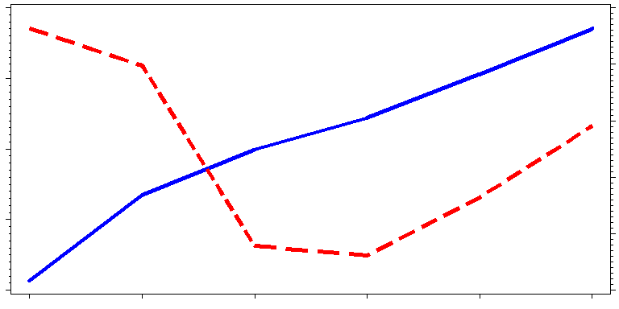
6
Nonprofit Employment: United States
Nonprofits
Total Private
11,500,000
116,000,000
Total Private
114,000,000
11,250,000
112,000,000
11,000,000
110,000,000
Nonprofits
10,750,000
108,000,000
10,500,000
106,000,000
2007
2008
2009
2010
2011
2012
Based upon Annual Averages

Slide 7
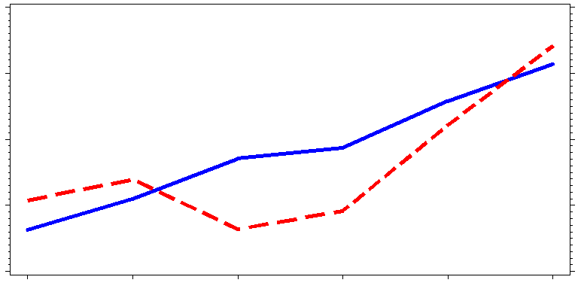
7
Nonprofit Employment: District of Columbia
Nonprofits
Total Private
130,000
480,000
125,000
470,000
120,000
Nonprofits
460,000
115,000
450,000
Total Private
110,000
440,000
2007
2008
2009
2010
2011
2012
Based upon Annual Averages

Slide 8
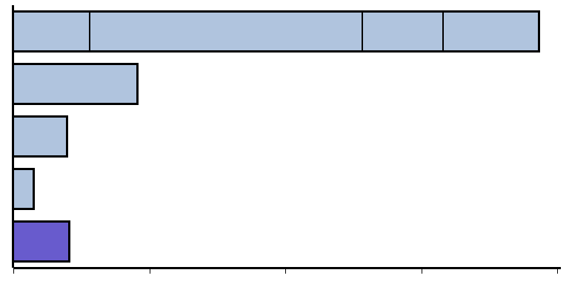
8
Largest Sectors of Nonprofit Employment:
United States
Total Nonprofit Private Sector Employment: 11,426,870
Hospitals
4,013,979 employees
Social Assistance
1,402,527 employees
Nursing and
Residential Care
1,186,090 employees
Ambulatory Services
1,114,369 employees
Health Care and
Social Assistance
7,716,964 (68%)
Education
1,812,270 (16%)
Other Services
784,675 (7%)
Arts, Entertainment
and Recreation
289,111 (3%)
All Remaining Sectors
817,683 (7%)
2,000,000
4,000,000
6,000,000
8,000,000
Based upon 2012 Annual Averages
Employment

Slide 9
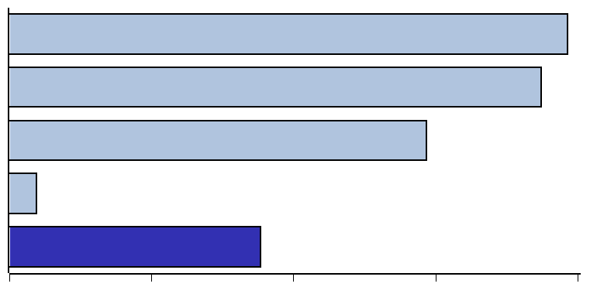
9
Largest Sectors of Nonprofit Employment:
District of Columbia
Washington, DC Nonprofit Total Private Sector Employment: 125,684
Health Care and
Social Assistance
39,283 (31%)
Education
37,427 (30%)
Other Services
29,346 (23%)
Arts, Entertainment
and Recreation
1,923 (2%)
All Remaining Sectors
17,705 (14%)
10,000
20,000
30,000
40,000
Employment
Based upon 2012 Annual Averages

Slide 10
10
Largest Share of Nonprofit Employment
by Industry in 2012
Industry | U.S. | D.C.
Total Private Employment | 10% | 27%
Health Care and Social Assistance | 46% | 63%
Educational Services | 70% | 94%
Other Services | 17% | 45%
Arts, Entertainment and Recreation | 15% | 28%

Slide 11
11
Per Capita Annual Wage Data
for Select Industries in 2012
 | U.S. |  | D.C.
Industry | Total Private | Nonprofit | Total Private | Nonprofit
Total Private | $49,200 | $46,567 | $76,456 | $66,052
Health Care and Social Assistance | $45,405 | $47,323 | $58,284 | $62,616
Educational Services | $44,508 | $48,457 | $55,713 | $56,290
Other Services | $30,089 | $33,256 | $77,677 | $76,048
Arts, Entertainment and Recreation | $33,744 | $28,105 | $64,777 | $41,696
Based upon Annual Averages

Slide 12
David Talan Email: talan.david@bls.gov Phone: 202-691-6467 Nonprofit Website http://www.bls.gov/bdm/nonprofits/nonprofits.htm
Notes:
If you have any questions or would like to visit the BED website at the BLS, here is the contact information.
The next BED press release will be out November 18, 2010 for 1st quarter 2010 BED data.
Thank you.

